Slide 1

Objects
Using a Simple Class

Slide 2
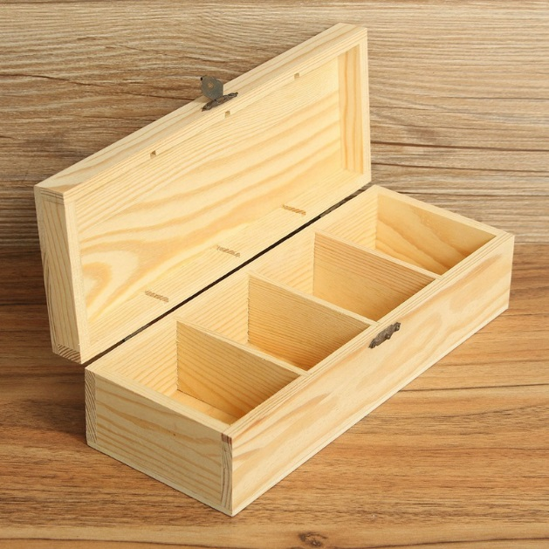
Learning Objectives
Last Few Weeks
Variables : float, color, boolean
Animation and Interaction
Events
Conditional statements – if, else if, else
Functions, parameter passing
This Weeks Objectives
Using a simple class
Modularised object information
constructors
methods

Slide 3
Animating Multiple Objects
When we animate an object, we need to store what information?
Where it is (x,y), how it moves – direction (dx, dy)
Every 2-dimensional animated object needs, at least, these
four variables:
float x; //(x, y) is the position
float y; //of the object
float dx; //speed along the x-axis
float dy; //speed along the y-axis
So, if you want to animate 3 different objects, you will need at least 12 variables:
float x1; //object 1
float y1;
float dx1;
float dy1;
Dealing with so many similarly-named variables is quite difficult in practice. It’s easy to write y2 instead of y1.
(x, y)
dx,
dy
float x2; //object 2
float y2;
float dx2;
float dy2;
float x3; //object 3
float y3;
float dx3;
float dy3;
Notes:
Unlike event procedures you have used up to this point, general procedures must be explicitly called.
You can create procedures or functions
Functions return a single value, procedures do not
Both functions and sub procedures can have arguments
You pass information into a sub procedure or a function through its arguments
Arguments must be typed in the prototype:
Private Sub DoSomething(Arg1 as String, Arg2 as Integer)
•••
End Sub
Functions are typed in addition to their arguments:
Private Function CalcInterest(Arg1 as Currency) As Currency
CalcInterest = <expression> 'return answer this way
End Function
Place functions in same place as event sub procedures

Slide 4
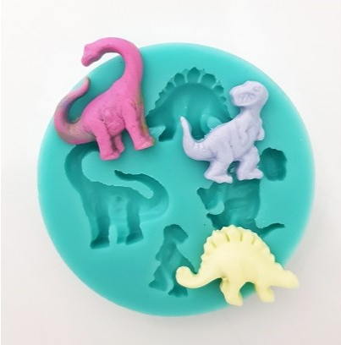
Introduction to a Class
To deal with this complexity we group our variables x, y, dx, and dy together into an Object.
To do this in Java, create a class:
class Sprite {
float x;
float y;
float dx;
float dy;
}
A bit like a collection of information about a single thing.
Class description – template for what these objects should contain
Using the Sprite class, we can now create Sprite objects like this:
Sprite ball = new Sprite();
ball.x = 40;
…
Sprite box = new Sprite();
x
y
dx
dy
mould
ball
box
x:40
y:20
x:30
y:10
dx:1
dy:1
dx:-1
dy:1

Slide 5
Using the Sprite Class
Calling
mySprite = new Sprite();
creates a new object that contains its own x, y, dx, and dy values.
We can set or get them like this:
ball.x = 10; // initialize ball
ball.y = 10;
ball.dx = 1;
ball.dy = 1.5;
box.x = 450; // initialize box
box.y = 450;
box.dy = -1;
ball.dx = box.dy; what effect?
class Sprite {
float x;
float y;
float dx;
float dy;
}
Sprite box, ball;
void setup()
{
box = new Sprite();
ball = new Sprite();
}
Class members
Class description
Declare Variables
Type : Sprite
ball
Create instances
(objects)
x:10
y:10
dx:1
dy:1.5
dx:-1
box
x:450
y:450
dx:
dy:-1
Dot means open the object and
access one of its member variables

Slide 6
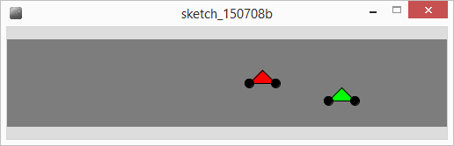
Simple Class
We can define class(es) to represent most problems (graphical and non-graphical)
Define new class(es) with different names
Exercise : motorbike race
What information would we need for a motorbike?
Write a motorbike class.

Slide 7
Class motorbike
colour as well
Need x position – will change
Need y position – fixed for a bike
Speed – change in x
Declare 2 instances of the class
As yet no actual box (memory)
In setup let’s create the memory using new
class motorbike {
int x = 5; //start at 5
int y; //how far down
int speed; //how fast
}
motorbike b1,b2;
void setup()
{
b1 = new motorbike();
b1.y = 50;
b2 = new motorbike();
b2.y = 70;
}
b1
b2
x: 5
x: 5
y:50
y:70
speed:
speed:

Slide 8
Drawing a bike
We could use an existing procedure to draw our motorbikes at a particular place
What would the line of code be to draw motorbike b1, pass 30 for the size?
Could add : drawMotorbike(b2.x, b2.y, 30); //draw 2nd bike
Better to have the motorbike take care of its own drawing (behaviours)
Example b1.render(); would draw bike b1, in b1’s current position
b2.render(); would draw bike b2, in b2’s current position
position stored in
object anyway
void draw()
{
background(125);
drawMotorbike(b1.x, b1.y, 30);
…
}
void drawMotorbike(int x, int y, int size)
{
float wheelHeight = size/3;
triangle(x,y,x+size,y,x+size/2,y-size/2);
ellipse(x,y,wheelHeight,wheelHeight);
ellipse(x+size,y,wheelHeight,wheelHeight);
}

Slide 9
Adding Methods
So far Class information consists of
where it is and direction information
Called Members
Member, an attribute of a class containing a value
We can also add Procedures & Functions to Class descriptions
Called Methods
Methods are functions (or Procedures) which tell a class how to behave
E.g. Draw itself – render
The class contains all the information about itself already
Makes sense to use it directly

Slide 10
Render Method
void draw()
{
background(125);
b1.render();
b1.x= b1.x + b1.speed;
b2.render();
b2.x=b2.x + b2.speed;
}
class motorbike {
int x = 5;
int y;
int speed=5;
int size=30;
void render()
{
float wHeight = size/3;
triangle(x,y,x+size,y,x+size/2,y-size/2);
ellipse(x,y,wHeight,wHeight); ellipse(x+size,y,wHeight,wHeight);
}
}
Information in class
No need for parameters
Do same thing for move

Slide 11
Move Method
Add move method to our class & how would we use it?
void draw()
{
background(125);
b1.render();
b1.move();
b2.render();
b2.move();
}
class motorbike {
int x = 5;
int y;
int speed=5;
int size=30;
void move()
{
x = x + speed;
}
void render()

Slide 12
Constructors
A special method, called when using the new command
motorbike b1; //declare an instance of motorbike class
b1 = new motorbike();
We can pass parameters to set member variable values
We might want to initialise y and speed values for motorbike
b1 = new motorbike(50, 5);
50 passed to y, 5 passed for speed

Slide 13
Example Constructor
motorbike b1,b2;
motorbike b3;
void setup()
{
b1 = new motorbike(50,5);
b2 = new motorbike(70,3);
b3 = new motorbike(100,2);
}
class motorbike {
int x = 5;
int y;
int speed;
int size=30;
motorbike( int y, int speed)
{
this.y = y;
this.speed = speed;
}
void move()
void render()
}
Constructor has same name
(return type) as class
this refers to variable
(member) within the class
Add a new instance of motorbike at 100 y, with speed 2

Slide 14
Function Methods
Our methods can handle behaviours
e.g. render();
Function methods can report – provide information
Racing motorbikes – might need to know if bike has reached the finish
Function returns a value
Finished() - type boolean – returns true or false
Should return true if bike has reached right hand side of screen

Slide 15
Finished function method
boolean finished(int finishLine)
{
if (speed>0)
return x >= finishLine; //left to right
else
return x <= finishLine; //right to left
}
if (b1.finished(490) == false)
b1.move();
x position of finish line
Add to motorbike class
Use within draw()

Slide 16
Exercise
Write a function called travelLeft which returns true if the bike is travelling right to left and false otherwise
Use sign of speed
What return type? Any parameters required?
boolean travelLeft(){
if (speed<0)
return true;
else
return false;
}

Slide 17
Summary
Class – template for an object, description of variables (class members – the mould)
Object – Variable with sub compartments - members
Methods – functions (procedures) how to use the class
Constructor – special method called on NEW command
Parameters – passing values to methods
A Class can have many constructors – must take different parameters

